Slide 1


Jenny Bush
01.25.2023

Slide 2

Outline
Executive Summary
Introduction
Methodology
Results
Conclusion
Appendix

Slide 3
Executive Summary
Summary of methodologies
Data Collection from SpaceX API using web scraping
Exploratory Data Analysis (EDA)
Data Wrangling, Data Visualization, and Interactive Visual Analytics using SQL and Folium
Machine Learning Prediction
Summary of all results
Identified what features best predict a successful rocket launch using EDA
Identified the model that performs best using test data and machine learning prediction.

Slide 4
Introduction
Project background and context
SpaceX advertises Falcon 9 rocket launches on its website with a cost of 62 million dollars; other providers cost upward of 165 million dollars each, much of the savings is because SpaceX can reuse the first stage. Therefore, if we can determine if the first stage will land, we can determine the cost of a launch.
Problems you want to find answers
Predict if the first stage of the SpaceX Falcon 9 will land successfully to better estimate the total cost for launches.

Slide 5

Section 1

Slide 6
Methodology
Executive Summary
Data collection methodology:
SpaceX data was collected from:
SpaceX REST API
Web Scraping Wikipedia
Perform data wrangling
Transformed and mapped raw data to determine training labels based on landing outcome and count data.
Perform exploratory data analysis (EDA) using visualization and SQL

Slide 7
Methodology
Executive Summary
Perform interactive visual analytics using Folium and Plotly Dash
Perform predictive analysis using classification models
Data was divided into training and test sets that were later evaluated using four different classification models: Logistic Regression, K-Nearest Neighbors, Decision Tree Classifiers, and Support Vector Machine (SVM)

Slide 8
Data Collection
Data was collected from the SpaceX REST API and from Wikipedia using Web Scraping
https://api.spacexdata.com/v4/rockets/
https://en.wikipedia.org/wiki/List_of_Falcon/_9/_and_Falcon_Heavy_launches

Slide 9
Data Collection – SpaceX API
Launch data was collected from the SpaceX public REST API using the GET request.
Basic data wrangling and formatting was used to filter results and remove null values.
https://github.com/creativerobotz/rocketship/blob/main/Data%20Collection%20API.ipynb
Request and parse SpaceX launch data using GET request
Filter data frame to only include Falcon 9 launches
Deal with missing values

Slide 10
Data Collection - Scraping
Extracted SpaceX Falcon 9 launch records HTML table from Wikipedia using web scraping.
Parse through the table and convert it into a Pandas data frame
https://github.com/creativerobotz/rocketship/blob/main/Data%20Collection%20with%20Web%20Scraping.ipynb
Request the Falcon 9 Launch Wiki page from its URL
Extract all column/variable names from the HTML table header
Create a data frame by parsing the launch HTML tables

Slide 11
Data Wrangling
Performed Exploratory Data Analysis (EDA) on dataset. Identified column type and percentage of missing values. Calculate the number of launches, sites, orbits, types, and the outcome. Create a landing outcome label from the outcome column
https://github.com/creativerobotz/rocketship/blob/main/EDA%20Data%20Wrangling.ipynb
Import
Tidy
Transform

Slide 12
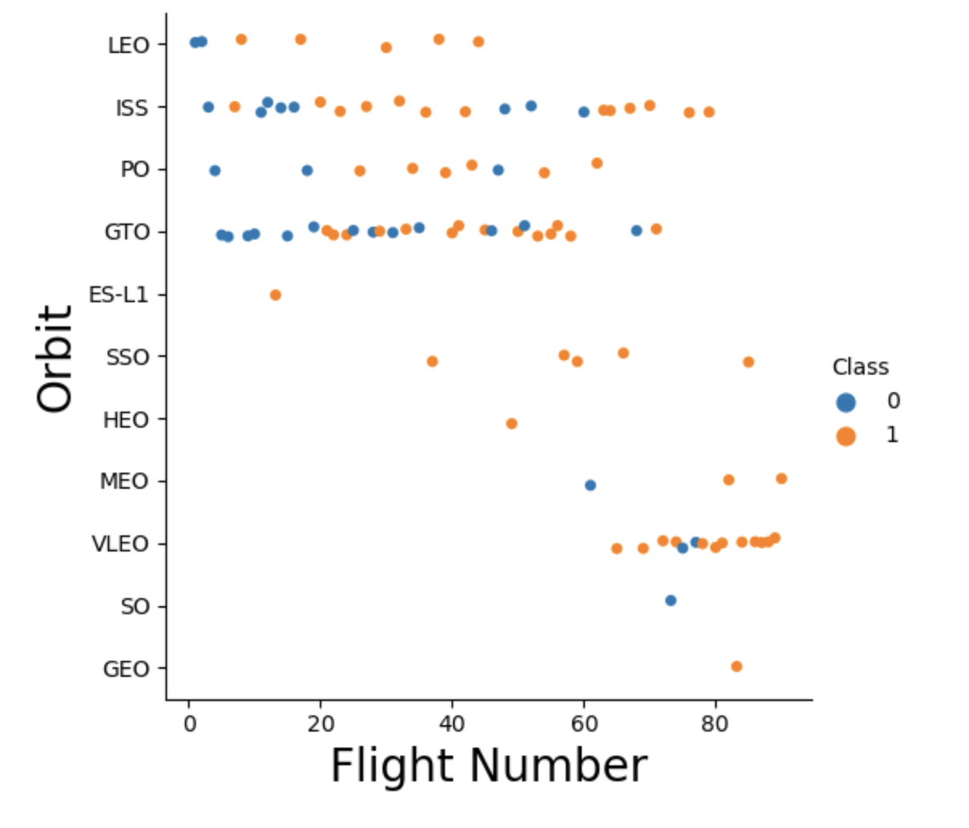
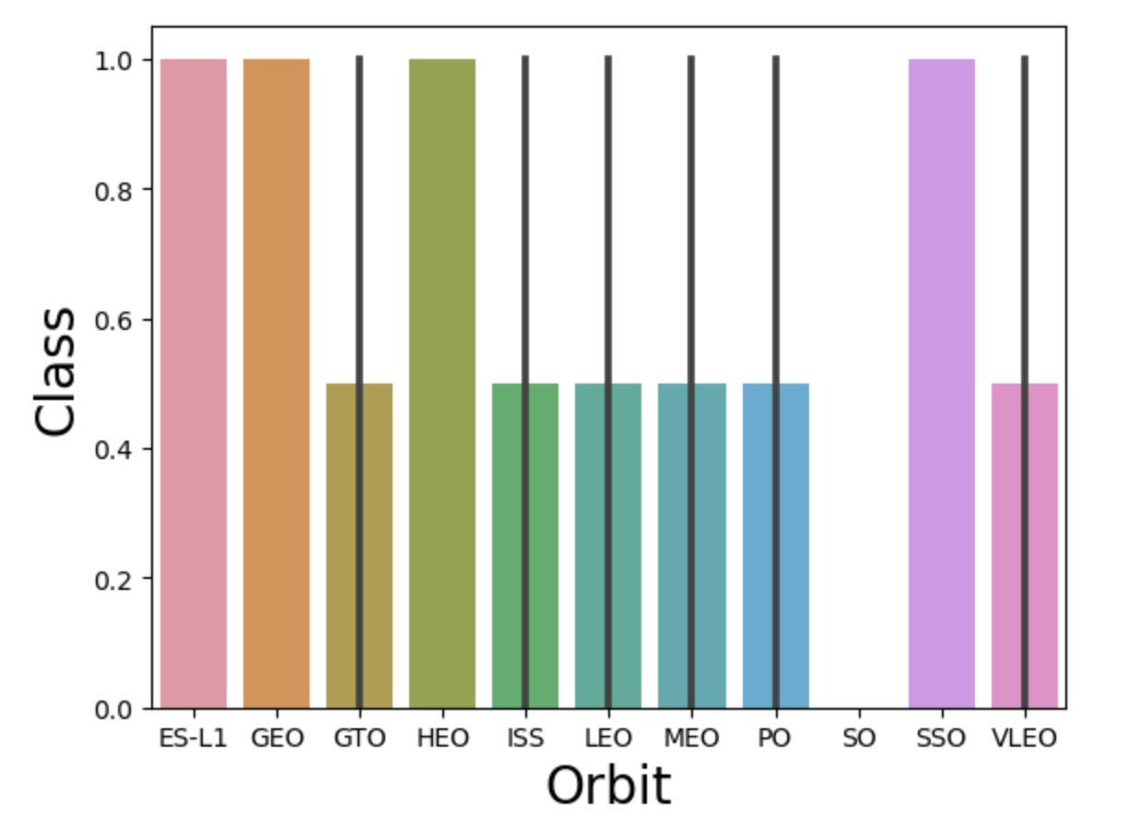
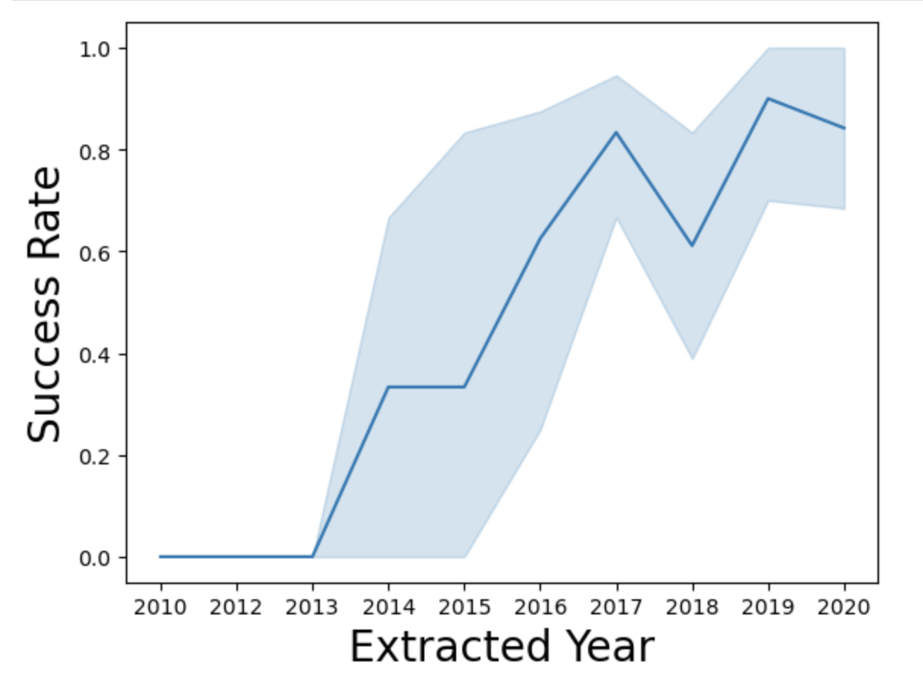
EDA with Data Visualization
Scatterplots, bar plots, and line plots were used to explore data and visualize relationships between paired types.
FlightNumber and Launch Site, Payload and Launch Site, Success rate and Orbit type, Payload and Orbit type, FlightNumber and Orbit type, and Launch success yearly trend.
https://github.com/creativerobotz/rocketship/blob/main/EDA%20with%20Data%20Visualization.ipynb

Slide 13
EDA with SQL
SQL queries performed:
Display the names of the unique launch sites in the space mission
Display 5 records where launch sites begin with the string 'CCA'
Display the total payload mass carried by boosters launched by NASA (CRS)
Display average payload mass carried by booster version F9 v1.1
List the date when the first successful landing outcome in ground pad was achieved.
List names of boosters which have success in drone ship & payload mass > 4000 but < 6000
List the total number of successful and failure mission outcomes
List names of booster_versions which have carried the maximum payload mass. Using subquery
List the failed landing_outcomes in drone ship, their booster versions, and launch site names for in year 2015
Rank the count of landing outcomes (such as Failure (drone ship) or Success (ground pad)) between the date 2010-06-04 and 2017-03-20, in descending order
https://github.com/creativerobotz/rocketship/blob/main/EDA%20with%20SQL.ipynb

Slide 14
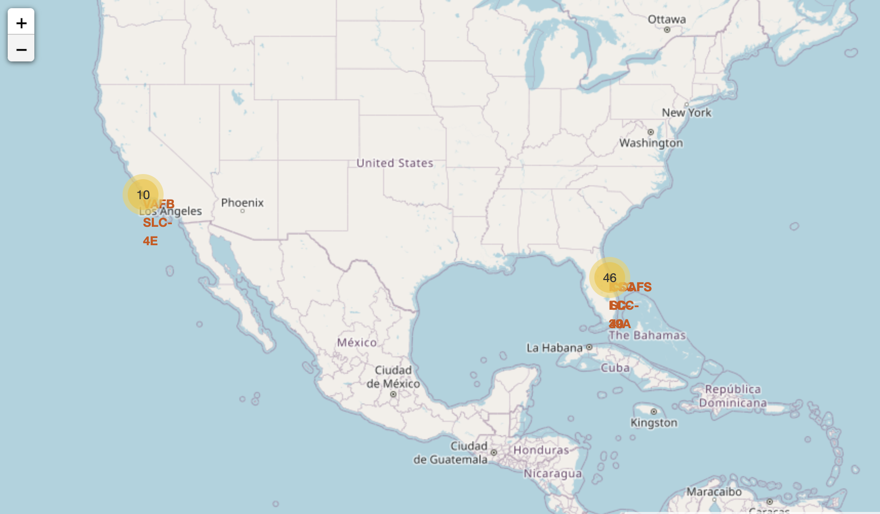
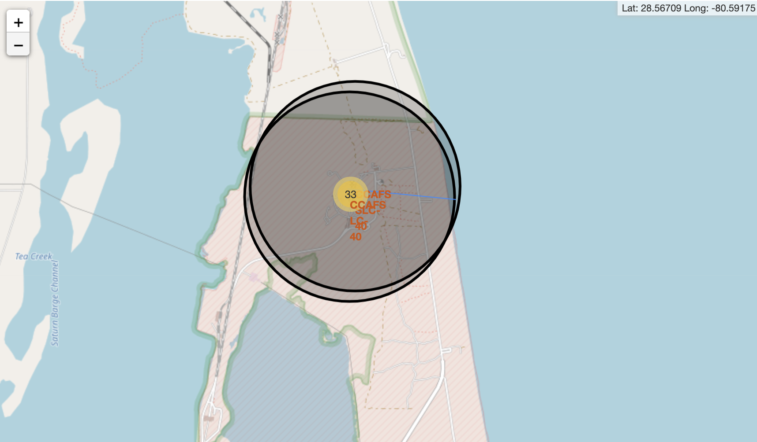
Build an Interactive Map with Folium
Map objects such as markers, circles, lines, and marker clusters were created and added to the folium map
Markers: Indicate points such as, launch sites on a map
Circles: Highlight area around specific coordinates on the map
Lines: Indicate the distances between a launch site to its proximities
Marker Cluster: markers close in proximity that have been grouped with each other
Marked launch outcomes for each site on map to find geographical patterns about launch sites.
https://github.com/creativerobotz/rocketship/blob/main/Interactive%20Visual%20Analytics.ipynb

Slide 15
Build a Dashboard with Plotly Dash
Created a pie chart visualizing launch success counts. Added a range slider to select payload to see if the variable payload is correlated to mission outcome.
Plot scatter plot with the x axis as the payload and the y axis launch outcomes to observe how payload may be correlated with mission outcomes for selected site(s).
This helps us determine the best launch site according to payload.
https://github.com/creativerobotz/rocketship/blob/main/Build%20a%20Dashboard%20with%20Plotly%20Dash.ipynb

Slide 16
Predictive Analysis (Classification)
Split the data into training and testing data using the function train_test_split.
Models are trained and hyperparameters are selected using the function GridSearchCV.
Find best Hyperparameter for SVM, Classification Trees and Logistic Regression
Find what method performs best using test data: Logistic Regression, K-Nearest Neighbors, Decision Tree Classifiers, and Support Vector Machine (SVM)
https://github.com/creativerobotz/rocketship/blob/main/Machine%20Learning%20Prediction.ipynb
Train and test models with best hyperparameter
Prepare and split data
Compare Results

Slide 17
Results
Exploratory data analysis results:
Space X has 4 unique launch sites.
The average payload carried by booster F9 v1.1 is 2928
The first successful ground pad landing was on 12-22-2015
Average launch success rate increased from 2013 to 2020
Booster version F9 B5 has carried the maximum payload mass
Launch site KSC LC 39A has had the most successful launches
Most launches happen on the east coast

Slide 18
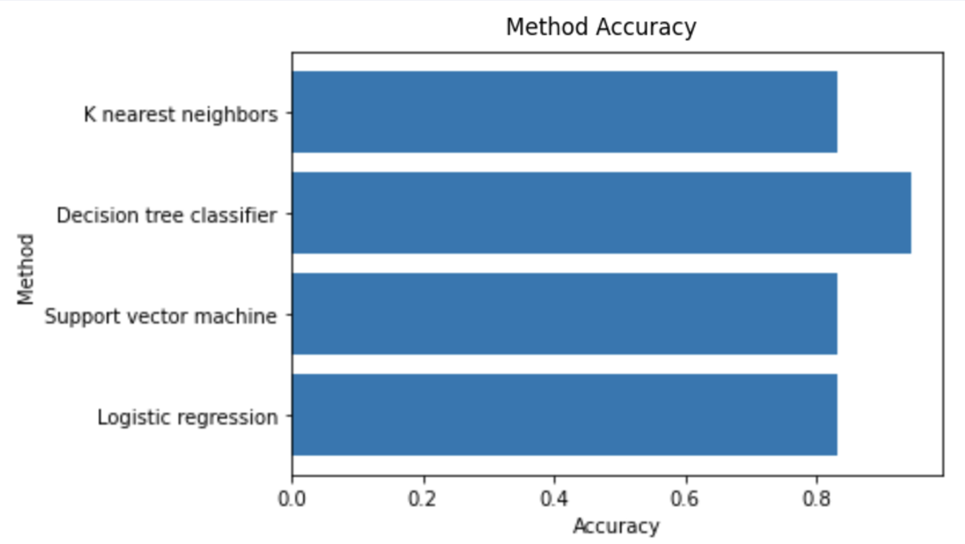
Results
Predictive analysis results:
Decision Tree Classifier is the model that performs best when predicting successful landings. Using hyperparameters, the DT model accuracy is 88% and test data accuracy is over 94%.

Slide 19

Section 2

Slide 20
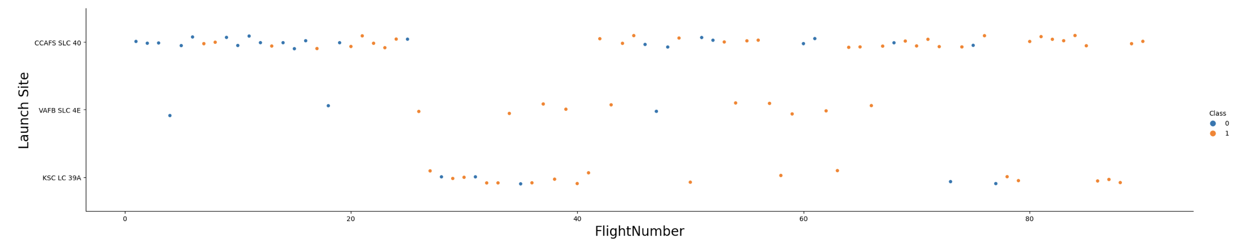
Flight Number vs. Launch Site
CCAFS SLC-40, has a success rate of 60%, while KSC LC-39A and VAFB SLC 4E has a success rate of 77%.
Most flights have been launched at CCAFS SLC-540
As the flight number increases, the first stage is more likely to land successfully.

Slide 21
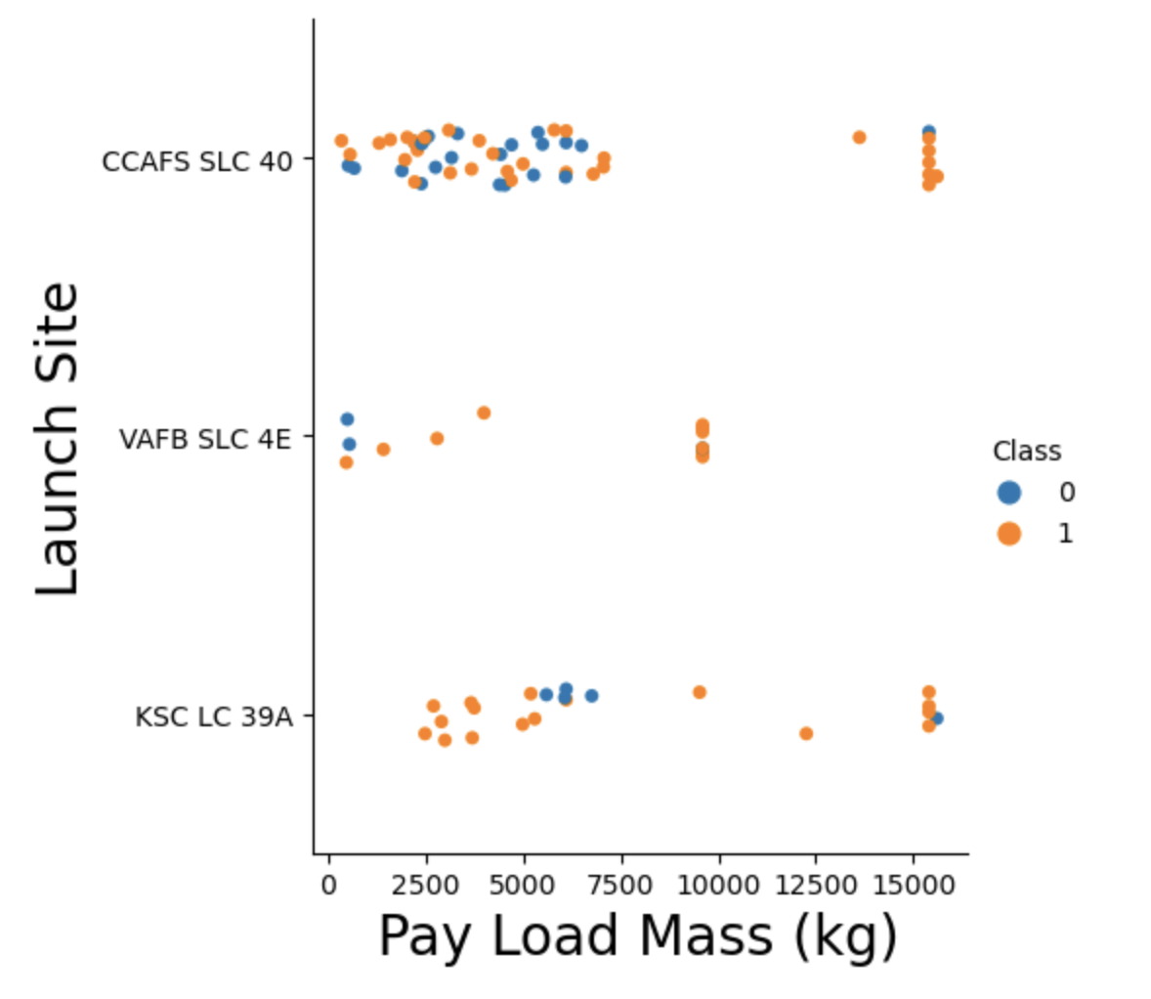
Payload vs. Launch Site
The majority of CCAFS SLC 40 payloads that are launched are lower in mass
For the VAFB-SLC launch site there are no rockets launched for heavy payload mass (greater than 10000)

Slide 22
Success Rate vs. Orbit Type
Orbits with the highest success rate:
ES-L1
GEO
HEO
SSO

Slide 23
Flight Number vs. Orbit Type
The LEO orbit success appears related to the number of flights.
Seems to be no relationship between flight number when in GTO orbit.

Slide 24
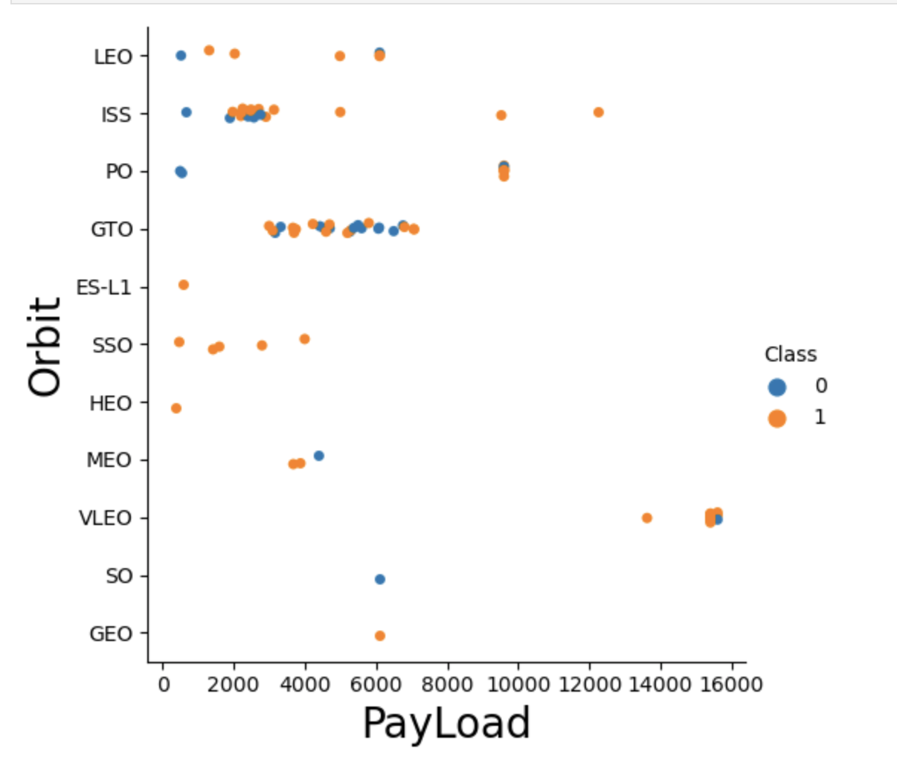
Payload vs. Orbit Type
Polar, LEO and ISS have a higher successful landing rate with heavy payloads.
We cannot distinguish this well for GTO because both successful and unsuccessful landing rates are there.
ISS orbit has the widest payload range

Slide 25
Launch Success Yearly Trend
Launch success rate shows a positive trend.
The success rate had been increasing since 2013 and continues to 2020

Slide 26
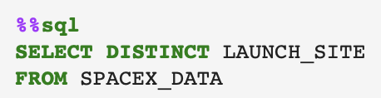
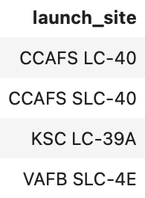
All Launch Site Names
According to data analysis there are 4 unique launch sites

Slide 27
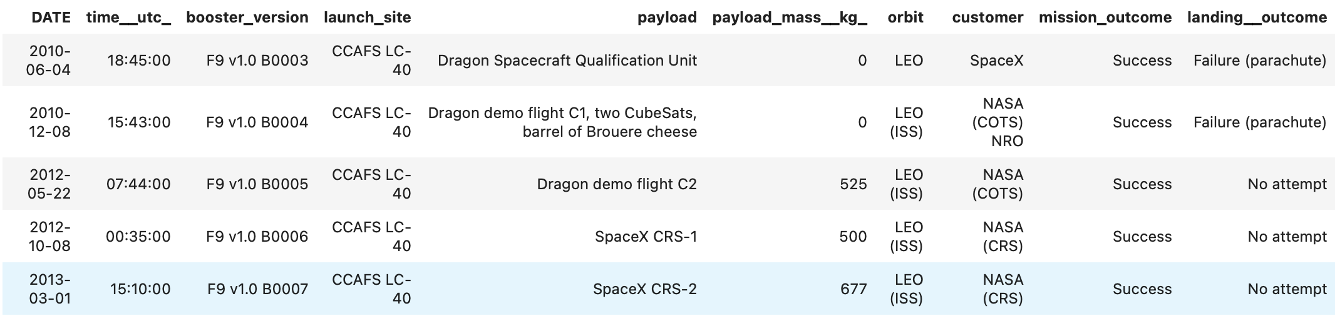
Launch Site Names Begin with 'CCA'
Using the SELECT* method we can display 5 records where launch sites begin with `CCA`

Slide 28
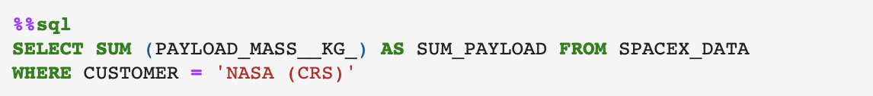
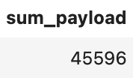
Total Payload Mass
The total payload carried by boosters from NASA was 45596 kg

Slide 29
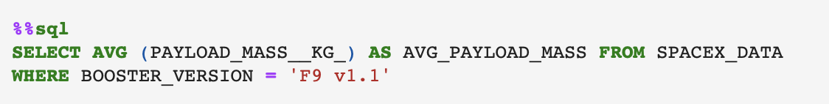
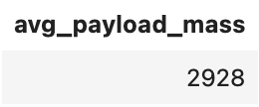
Average Payload Mass by F9 v1.1
The average payload mass carried by booster version F9 v1.1 was 2928 kg

Slide 30
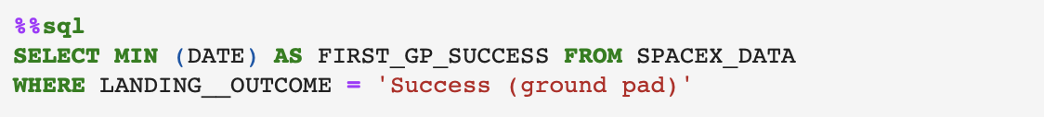
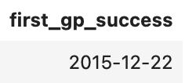
First Successful Ground Landing Date
Date of the first successful landing outcome on ground pad:

Slide 31
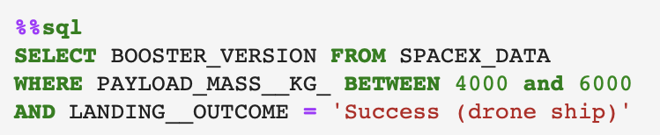
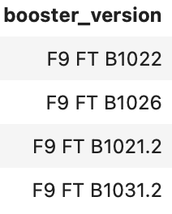
Successful Drone Ship Landing with Payload between 4000 and 6000
Names of boosters which have successfully landed on drone ship and had payload mass greater than 4000 but less than 6000:

Slide 32
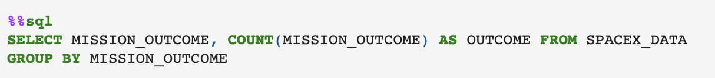
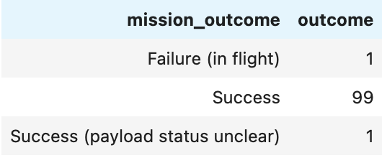
Total Number of Successful and Failure Mission Outcomes
The total number of successful and failure mission outcomes:

Slide 33
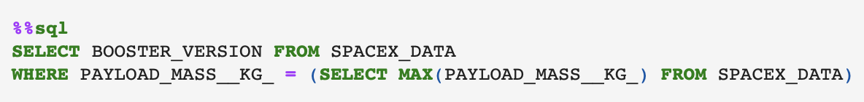
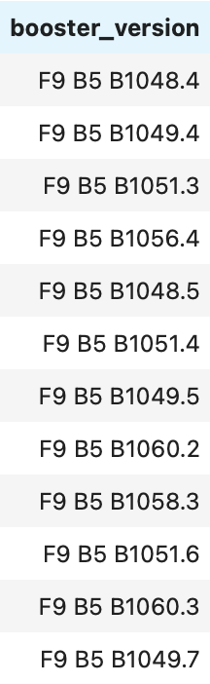
Boosters Carried Maximum Payload
Boosters which have carried the maximum payload mass:
Booster version F9 B5 has carried the maximum payload mass

Slide 34
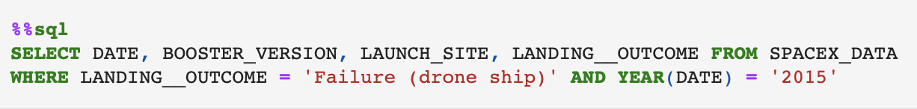
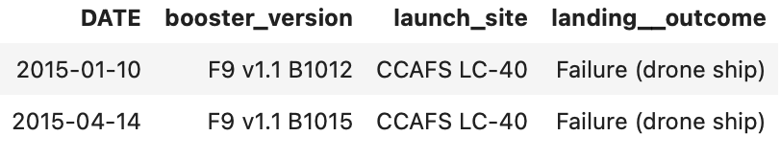
2015 Launch Records
List of failed landing_outcomes in drone ship, their booster versions, and launch site names for in year 2015

Slide 35
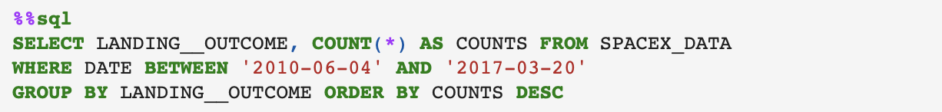
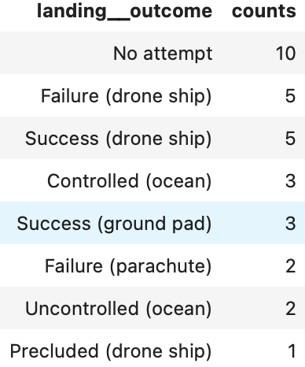
Rank Landing Outcomes Between 2010-06-04 and 2017-03-20
Rank of all landing outcomes between the date 2010-06-04 and 2017-03-20, in descending order:

Slide 36

Section 3

Slide 37
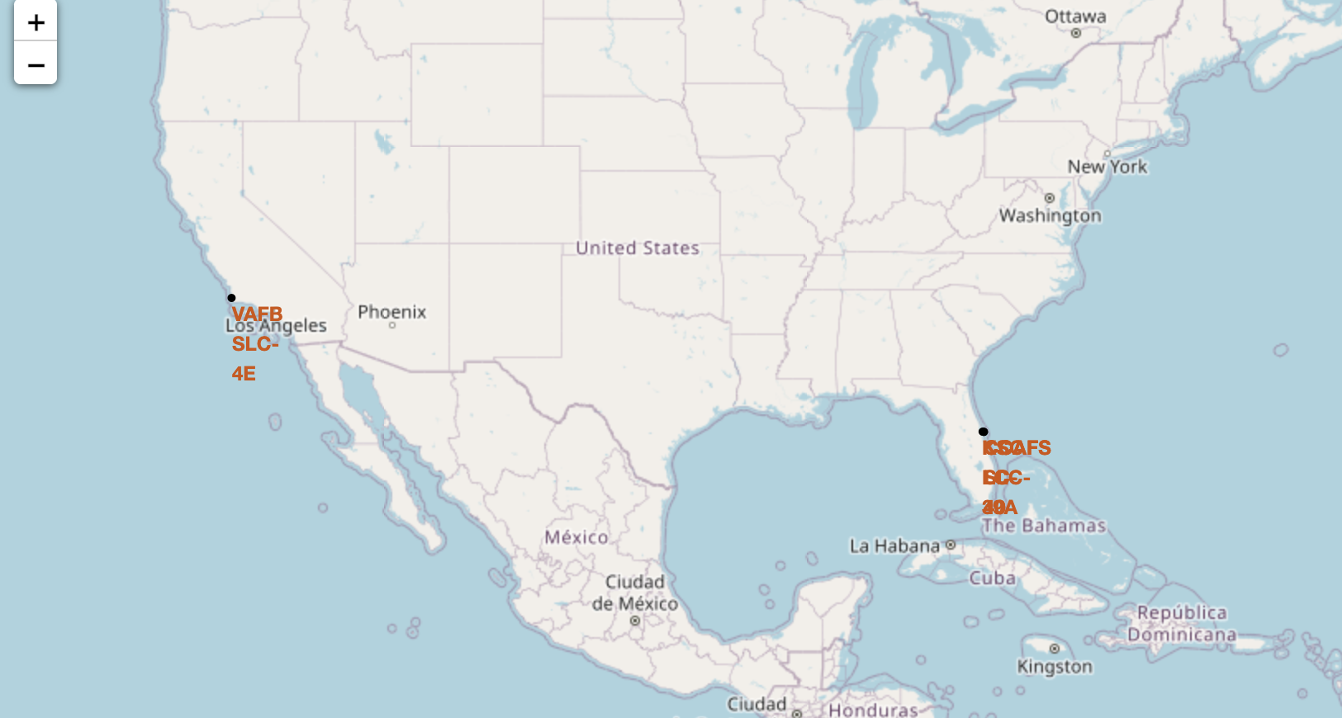
All launch sites
Launch sites are located near both the east and west coast. This can be due to safety in case of failure to launch there is water nearby.
Most launch sites are located near the equator; rockets launched here get additional velocity that helps save on fuel and boosters.

Slide 38
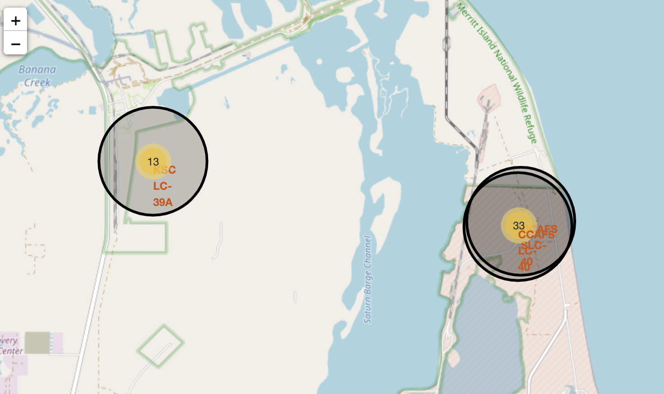
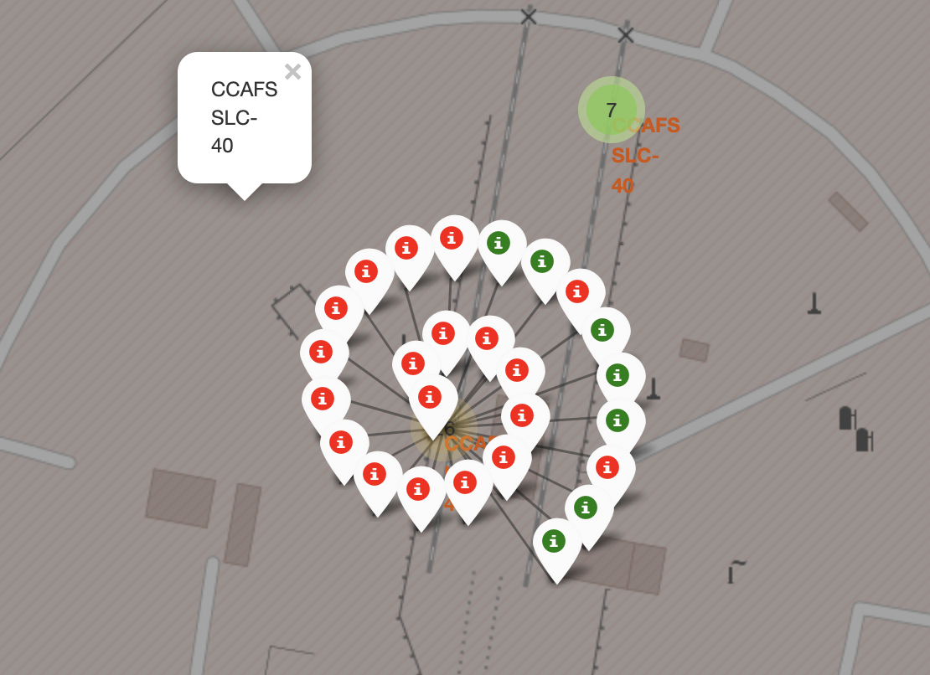
Launch Outcome by Site
Added the outcome of each launch for each site.
For each successful launch we use a green marker and if a launch failed, we use a red marker.

Slide 39
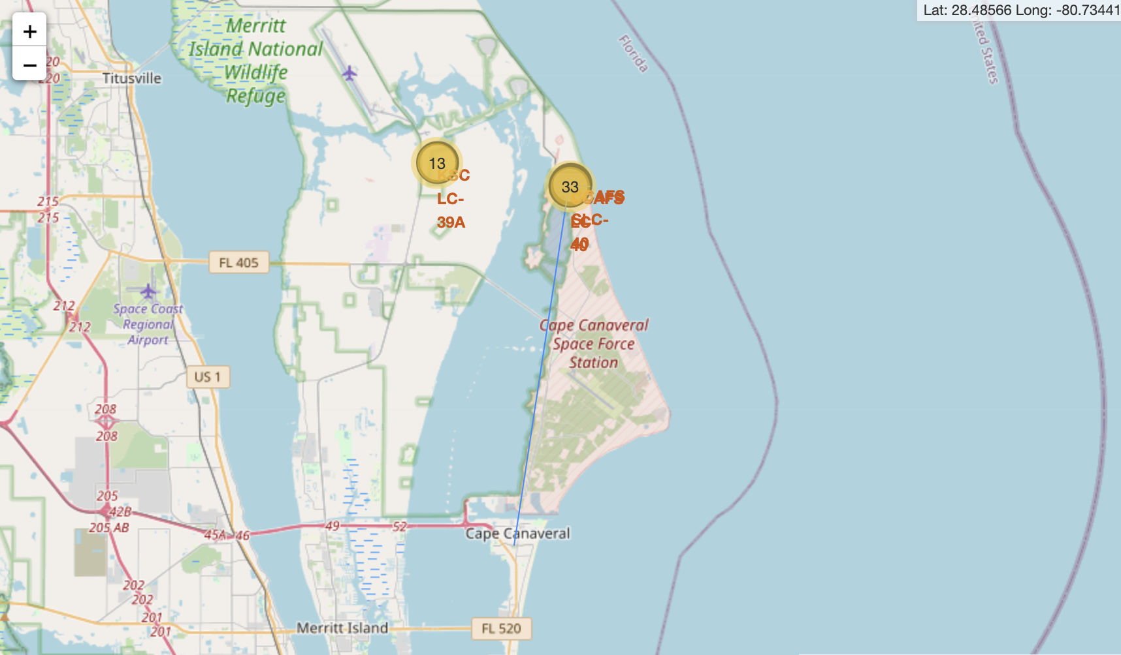
Launch sites and distance to proximities
Launch sites are mainly located near the sea.
Launch sites are close to highways and railways, allowing for easy transport.
Launch sites are further away from cities, minimizing danger to densely populated areas.

Slide 40

Section 4

Slide 41
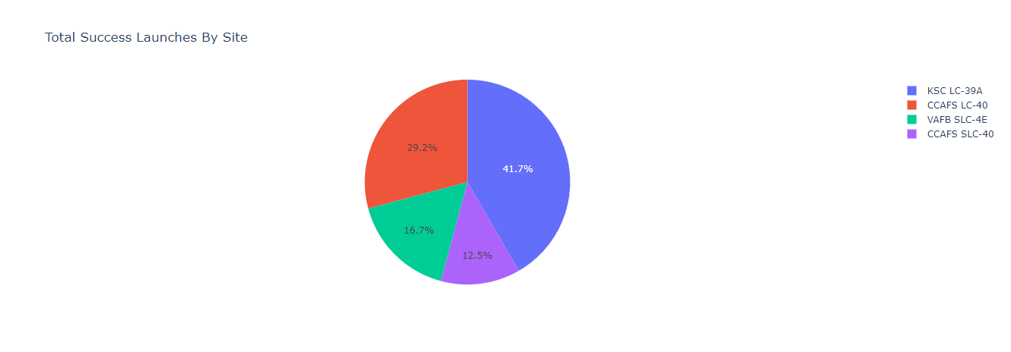
Successful Launches by Site
The pie chart shows the launch success count for all four unique sites.
Launch site KSC LC-39A has the most successful launches.

Slide 42
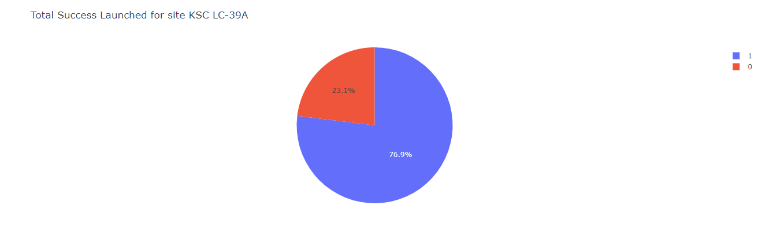
Launch Success Ratio
Launch site KSC LC-39A has the largest successful launches with 10 total.
KSLC-39A launch success rate is 76.9%, the failure rate is 23.1%.

Slide 43
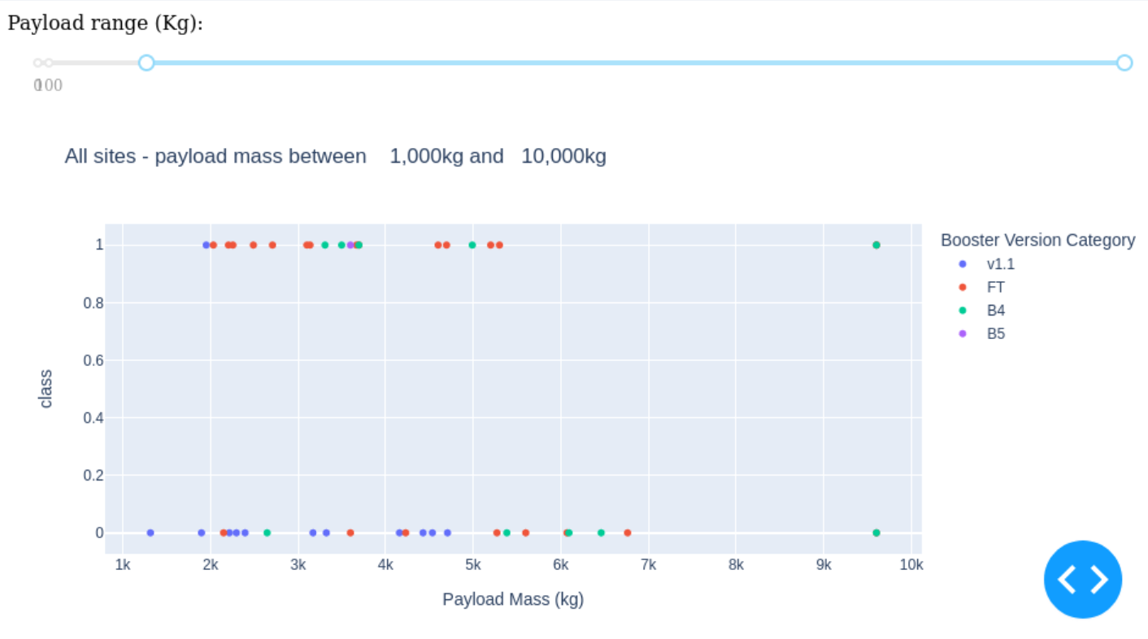
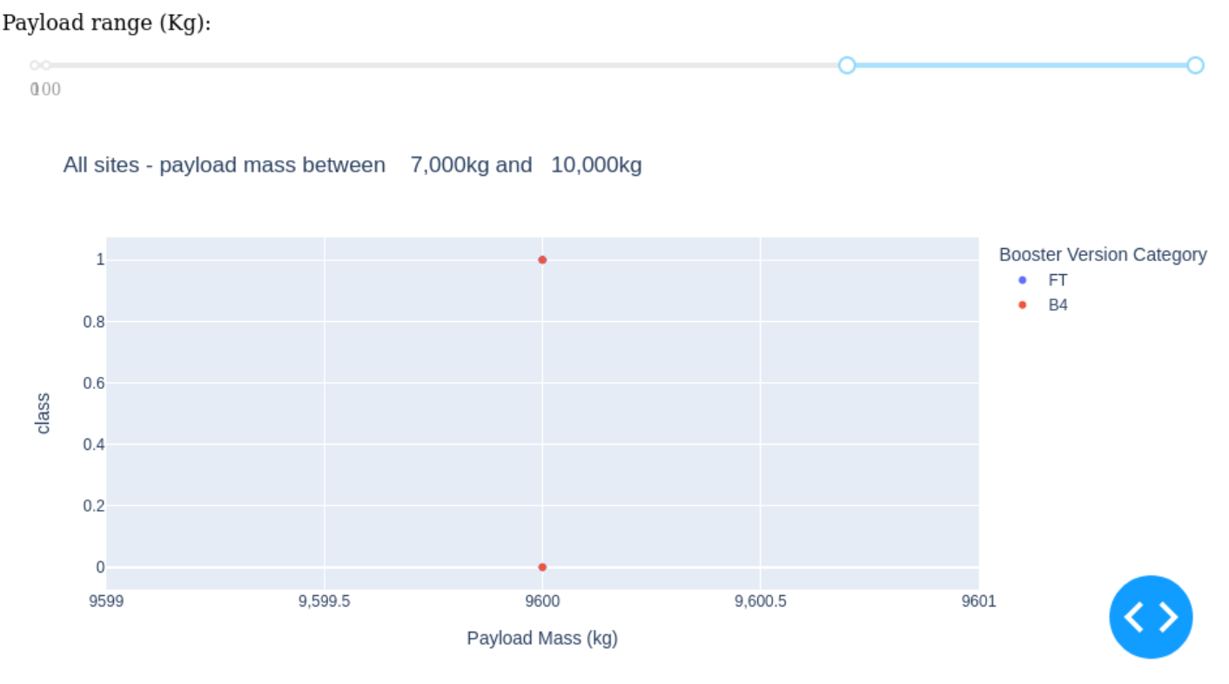
Payload vs. Launch Outcome
F9 booster version FT has the highest launch success.
The success rates for low weighted payloads is higher than heavy weighted payloads.
Success = 1
Failed = 0

Slide 44

Section 5

Slide 45
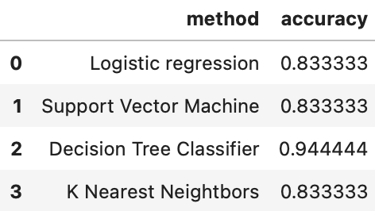
Classification Accuracy
Decision Tree Classifier model has the highest classification accuracy.

Slide 46
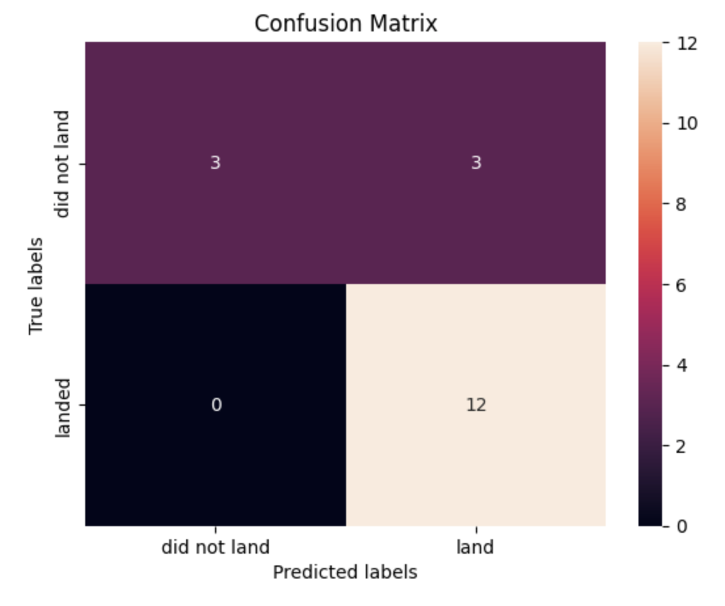
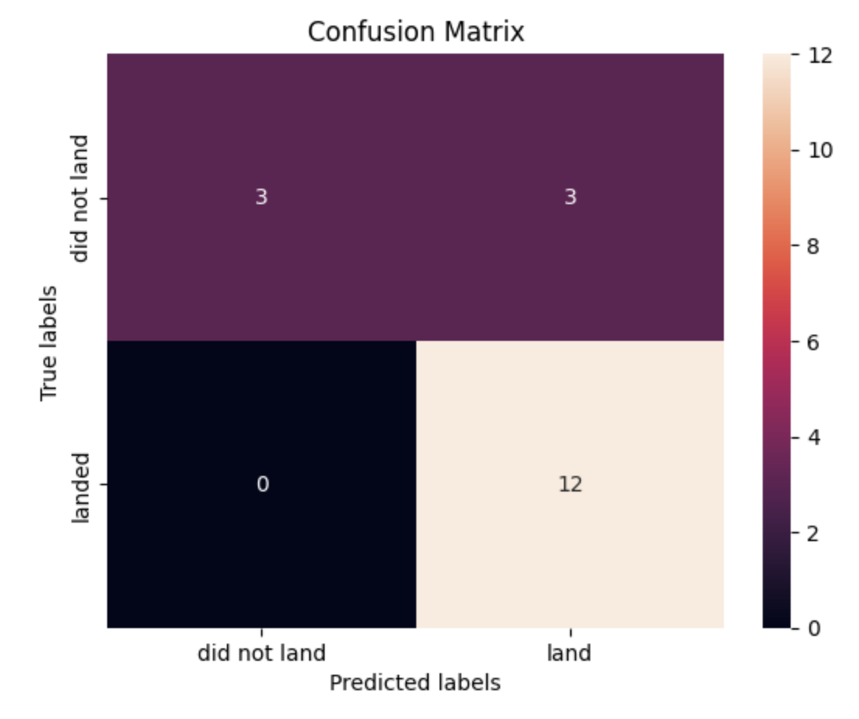

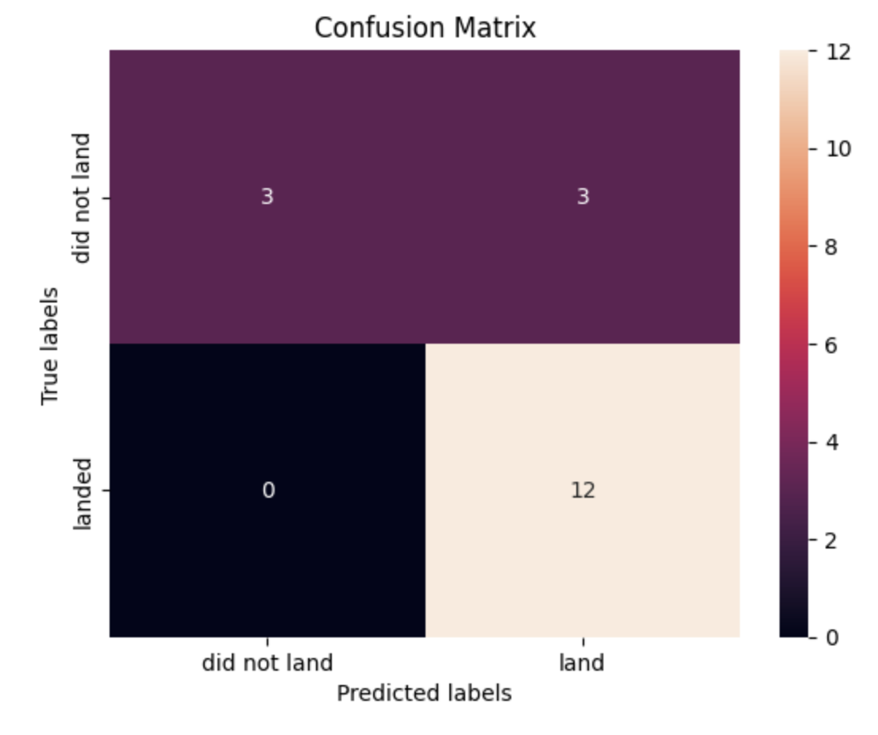
Confusion Matrix
Examining the confusion matrices:
See logistic regression can distinguish between different classes.
Allows us to visualize predictive analytics such as specificity, accuracy, and precision.
See a major problem is false positives.

Slide 47
Conclusions
Launch site CCAFS SLC-540 has the highest launch rate.
Launch site KSC LC-39A has the most successful launches with the highest launch success rate.
Lighter payloads have a higher launch success rate compared to heavier payloads.
The location of a launch site is determined on what factors make a launch most successful.
Far from: cities; near: the equator, the sea, highways, and railroads.
The rate of successful landing outcomes has improved over time.
This matches the increasing knowledge of processes and rockets
Decision Tree Classifier can be used to predict successful landings and increase profits.

Slide 48
Appendix
Folium maps do not show up on GitHub, screenshots of maps are posted in this assignment.
Code for classification accuracy bar chart:
import numpy as np
import matplotlib.pyplot as plt
plt.barh(method, accuracy)
plt.title('Method Accuracy')
plt.xlabel('Accuracy')
plt.ylabel('Method')
plt.show()
GitHub Repository: https://github.com/creativerobotz/rocketship

Slide 49


